Slide 1
Java OOPS concepts
OOPS concepts

Slide 2
First Object Oriented Programming Language?
Simula is considered as the first object-oriented programming language

Slide 3
Pure/Truly object-oriented programming language.
The programming paradigm where everything is represented as an object, is known as truly object-oriented programming language.
Smalltalk is considered as the first truly object-oriented programming language.

Slide 4
Is Java Pure Object Oriented Programming Language?
No
Java supports primitive data types

Slide 5
OOPs (Object Oriented Programming System)
Object means a real word entity such as pen, chair, table etc.
Object-Oriented Programming is a methodology or paradigm to design a program using classes and objects.
It simplifies the software development and maintenance

Slide 6
The OOP Principles All object-oriented programming languages provide mechanisms that help you implement the object-oriented model. They are 3
Abstraction
Encapsulation
Polymorphism

Slide 7
OOPS concepts
Abstraction
Encapsulation
Polymorphism
Inheritance

Slide 8
oops concept definition Benefit
-------------- -------------- -------------------
1 Abstraction Hiding unnecessary data Reduce the code
2 Encapsulation wrapping of data in to a sing unit security
3 Polymorphism Able to create many forms Flexibility
4 Inheritance Acquire parent object data Code sharing
,behavior to child object

Slide 9
Inheritance
When one object acquires all the properties and behaviors of parent object i.e. known as inheritance.

Slide 10
Advantages
1. Code reusability
2. Achieves runtime polymorphism.

Slide 11
Polymorphism
Polymorphism in java is a concept by which we can perform a single action by different ways.
Polymorphism is derived from 2 greek words: poly and morphs. The word "poly" means many and "morphs" means forms. So polymorphism means many forms.
There are two types of polymorphism in java:
compile time polymorphism
runtime polymorphism.
We can perform polymorphism in java by method overloading and method overriding.

Slide 12
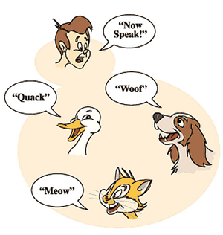
Polymorphism
example can be to speak something e.g. cat speaks meaw, dog barks woof etc.

Slide 13
Abstraction
Hiding internal details and showing functionality is known as abstraction.
or example: phone call, we don't know the internal processing.
In java, we use abstract class and interface to achieve abstraction.
Example: Keyboard, Phone

Slide 14

Encapsulation
Binding (or wrapping) code and data together into a single unit is known as encapsulation. For example: capsule, it is wrapped with different medicines.
A java class is the example of encapsulation. Java bean is the fully encapsulated class because all the data members are private here.

Slide 15
OOPS Concepts
Inheritance gives → Code reusability or Code sharing
Polymorphism gives→ Flexibility
Abstraction gives → functionality to reduce the code
Encapsulation gives → security

Slide 16
Advantage of OOPs over Procedure-oriented programming language
1)OOPs makes software development and maintenance easier where as in Procedure-oriented programming language it is not easy to manage if code grows as project size grow
2) Code reusability or Code sharing
3) Flexibility
4) Functionality to reduce the code
5) security

Slide 17
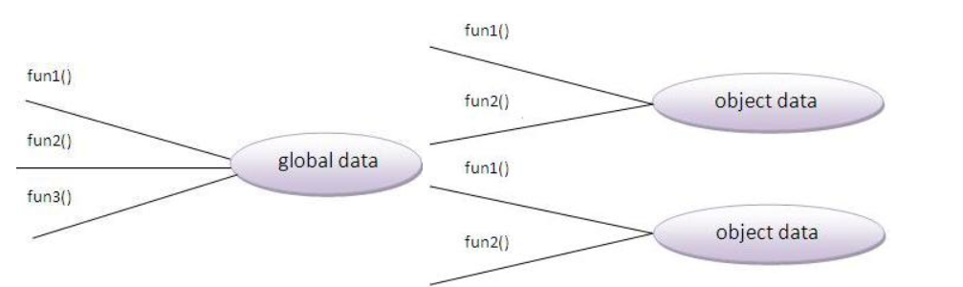
Advantage of OOPs over Procedure-oriented programming language

Slide 18
What is difference between object-oriented programming language and object-based programming language (OOPL Vs OBPL)?
Object based programming language follows all the features of OOPs except Inheritance.
JavaScript and VBScript are examples of object based programming languages.

Slide 19
OBPL supports
Abstraction
Encapsulation
Polymorphism

Slide 20
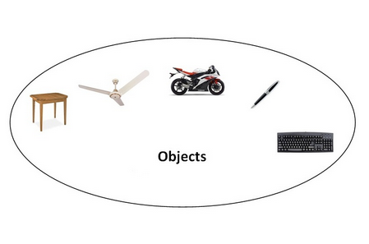
Object
Object: An object is anything that exists in this real world. An object has properties and behaviors (actions).
In our program variables are used to represent properties. Actions are represented by methods.
i.e.; An object contains variables and methods. i.e.; Objects need memory. JVM will allocate the memory required for objects using new keyword.
For example: chair, pen, table, keyboard, bike etc. (tangible and intangible).

Slide 21
An object has three characteristics:
SBI
state: represents data (value) of an object.
behavior: represents the behavior (functionality) of an object such as deposit, withdraw etc.
identity: Object identity is typically implemented via a unique ID. The value of the ID is not visible to the external user. But, it is used internally by the JVM to identify each object uniquely.

Slide 22
Examples
Pen
States: cost, color, type, size
Behaviors: write(),
identity: Renoylds -unique id
Car:
States: model, type, cost
behavior: drive();
identity: benz

Slide 23
What is a Class?
It is a template or blueprint from which objects are created. So object is the instance(result) of a class.
Class doesn’t exist physically, it is only our idea.

Slide 24
Below table depicts some class names and objects.
Class names | Objects
Flower | Lilli, Jasmine, Lotus
Book | NoteBook, TextBook, RefBook
Actor | Chiranjeevi, Kamal Hasan, Rajani
Actress | Radha, Anushka, Tamnna, Sneha Ullal
Shirt | T-Shirt, S-Sleve, Glasour
Sweet | Jilebi, Coa, Kalakanda

Slide 25
A class in java can contain:
fields
methods
constructors
blocks
classes and interfaces

Slide 26
Representation of variable in various languages
C C++ java
int id; variable data member field /properties
main() function data function method

Slide 27
Syntax to declare a class:
class <class_name>{
fields;
methods;
………………………
…………………
}

Slide 28
Syntax for Object creation (Instantiation)
//classname object/reference name = new classname();
Ex:
Student student = new Student();

Slide 29
Accessing object data
Variables and methods in the class are accessible through object
Syntax:
Objectname/referencevariablename.variableName;
Objectname/referencelvariablename.methodName();
Ex:
Student stud = new Student();
stud.id;
stud.displayStudentDetails();

Slide 30
Simple Example of Object and Class
public class Student {
int id = 101;
String name="James";
public static void main(String[] args) {
Student stud = new Student();
System.out.println(stud);
System.out.println("Student id: "+stud.id);
System.out.println("Student name: "+stud.name);
}}

Slide 31
new Keyword
The new keyword is used to allocate memory at runtime.
We are creating the object of the Student class by new keyword and printing the objects value.

Slide 32
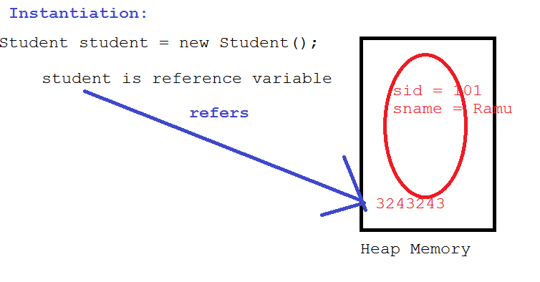
Memory allocation of object

Slide 33
Instance Variable
A variable that is created inside the class but outside the method, is known as instance variable. Instance variable doesn't get memory at compile time.
It gets memory at runtime when object(instance) is created. That is why, it is known as instance variable.

Slide 34
Example of Object and class that maintains the records of students
public class Student {
int id ;
String name;
void insertRecord(int i, String n){
id = i;
name = n;
}
void displayStudentDetails(){
System.out.println("ID: "+id+" Name: "+name);
}
public static void main(String[] args) {
Student s1 = new Student();
s1.insertRecord(101, "Devarshaa");
s1.displayStudentDetails();
Student s2 = new Student();
s2.insertRecord(102, "Sita");
s2.displayStudentDetails();
} }
}

Slide 35
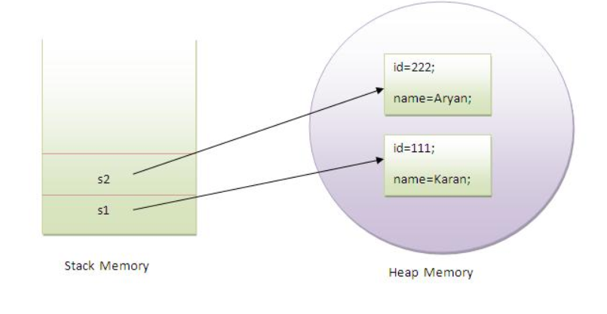
Memory allocation

Slide 36
Notes
s1 and s2 both are reference variables that refer to the objects allocated in memory

Slide 37
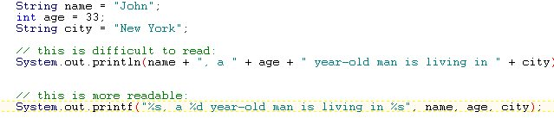
Use System.out.printf() for formatting String with arguments make the code more readable:

Slide 38
Different ways to create an object in Java?
By new keyword
By newInstance() method
By clone() method
By factory method
By deserialization etc.

Slide 39
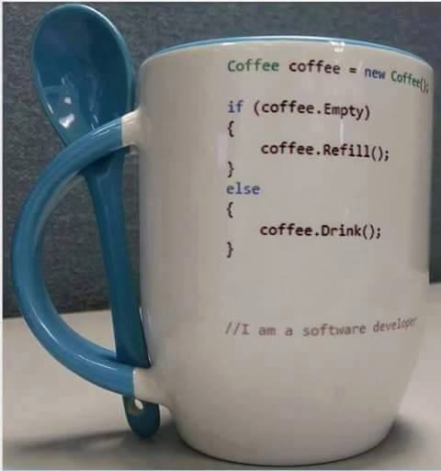
Let’s have coffee now ☺ ☺

Slide 40
Anonymous object
Anonymous simply means nameless.
An object that have no reference is known as anonymous object.
Or Nameless object

Slide 41
Anonymous Object
public class Hello {
void printHello(){
System.out.println("Hello, How are you?");
}
public static void main(String[] args) {
new Hello().printHello();
}}

Slide 42
Creating multiple objects by one type only
Rectangle r1=new Rectangle();
Rectangle r2=new Rectangle();//creating two objects

Slide 43
***Difference between object and class
No. | Object | Class
1) | Object is an instance of a class. | Class is a blueprint or template from which objects are created.
2) | Object is a real world entity such as pen, laptop, mobile, bed, keyboard, mouse, chair etc. | Class is a group of similar objects.
3) | Object is a physical entity. | Class is a logical entity.
4) | Object is created through new keyword mainly e.g. Student s1=new Student(); | Class is declared using class keyword e.g. class Student{}
5) | Object is created many times as per requirement. | Class is declared once.
6) | Object allocates memory when it is created. | Class doesn't allocated memory when it is created.
7) | There are many ways to create object in java such as new keyword, newInstance() method, clone() method, factory method and deserialization. | There is only one way to define class in java using class keyword.

Slide 44
Polymorphism
Able to create many forms
Types of Polymorphism
1. Static Polymorphism 2. Dynamic Polymorphism
Method Overloading MethodOverriding

Slide 45
Method Overloading

Slide 46


Slide 47
Method Overloading
If a class has multiple methods with same name but different parameters, it is known as Method Overloading.

Slide 48
Advantages of Method overloading
Method overloading increases the readability of the program.

Slide 49
Different ways to overload the method
By changing number of arguments
By changing the data type
By changing order of the arguments
Note:
In java, Methood Overloading is not possible by changing the return type of the method.

Slide 50
1)Example of Method Overloading by changing the no. of arguments
class Calculation{
void sum(int a,int b){System.out.println(a+b);}
void sum(int a,int b,int c){System.out.println(a+b+c);}
public static void main(String args[]){
Calculation obj=new Calculation();
obj.sum(10,10,10);
obj.sum(20,20);
}
}

Slide 51
2)Example of Method Overloading by changing data type of argument
class Calculation{
void sum(int a,int b){System.out.println(a+b);}
void sum(double a,double b){System.out.println(a+b);}
public static void main(String args[]){
Calculation obj=new Calculation();
obj.sum(10.5,10.5);
obj.sum(20,20);
}
}

Slide 52
3)Example of Method Overloading by changing order of arguments
class Calculation{
void sum(int a, double b){System.out.println(a+b);}
void sum(double a, float b){System.out.println(a+b);}
public static void main(String args[]){
Calculation obj=new Calculation();
obj.sum(10,10.5);
}
}

Slide 53
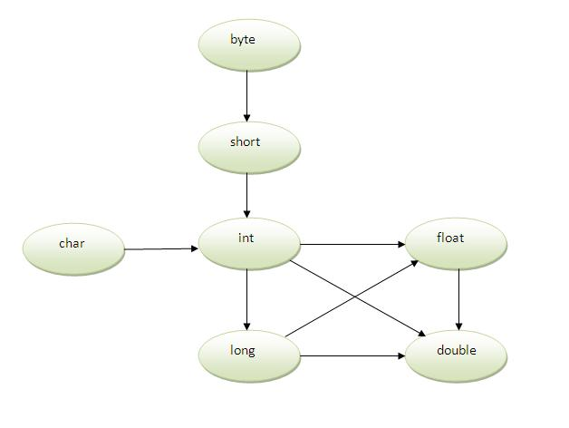
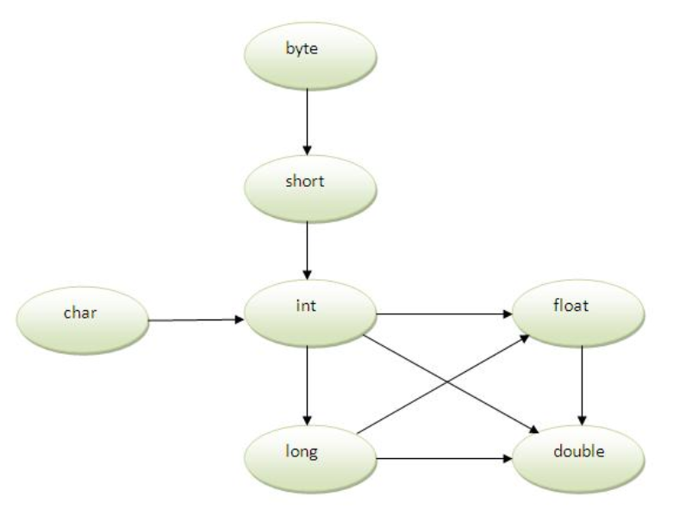
Method Overloading and TyType Promotion
One type is promoted to another implicitly if

Slide 54
Notes:
As displayed in the above diagram,
byte can be promoted to short, int, long, float or double.
The short datatype can be promoted to int,long,float or double.
The char datatype can be promoted to int,long,float or double and so on.

Slide 55
Example of Method Overloading with TypePromotion
class OverloadingCalculation{
void sum(int a,long b){System.out.println(a+b);}
public static void main(String args[]){
OverloadingCalculation obj=new OverloadingCalculation();
obj.sum(20,20);//now second int literal will be promoted to long
}
}

Slide 56
Example of Method Overloading with Type Promotion in case of ambiguity
class OverloadingCalculation{
void sum(int a,long b){System.out.println("a method invoked");}
void sum(long a,int b){System.out.println("b method invoked");}
public static void main(String args[]){
OverloadingCalculation obj=new OverloadingCalculation();
obj.sum(20,20);//now ambiguity
}
}

Slide 57
Can we overload main() method?
Yes, You can have any number of main methods in a class by method overloading. Let's see the simple example:

Slide 58
Example
class Overloading{
public static void main(int a){
System.out.println(a);
}
public static void main(String args[]){
System.out.println("main() method invoked");
main(10);
}
}

Slide 59
Constructor in Java
Constructors

Slide 60
What is constructor?
Constructor initializes the object
It constructs the values i.e. provides data for the object that is why it is known as constructor.
Java constructor is invoked at the time of object creation.

Slide 61
Types of java constructors
Default constructor (no-parameter constructor)
Parameterized constructor

Slide 62
Java Default Constructor
A constructor that have no parameter is known as default constructor.
Syntax:
<class_name>(){
…………
}

Slide 63
Example of default constructor
public class Bike {
Bike(){
System.out.println("Bike is created");
}
public static void main(String[] args) {
new Bike();
}
}

Slide 64
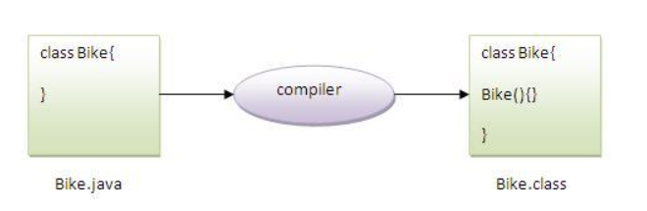
Compiler automatically creates default constructor if any constructor is not written by programmer

Slide 65
What is the purpose of default constructor?
Default constructor provides the default values to the object like 0, null etc. depending on the type.

Slide 66
Example of default constructor that displays the default values
public class Student {
int sid;
String sname;
void displayStudentDetails(){
System.out.println(sid+" "+sname);
}
public static void main(String[] args) {
Student student1 = new Student();
student1.displayStudentDetails();
}
}

Slide 67
Java parameterized constructor
A constructor that have parameters is known as parameterized constructor.

Slide 68
Why use parameterized constructor?
Parameterized constructor is used to provide different values to the distinct objects.

Slide 69
Example of parameterized constructor
public class Student {
int sid;
String sname;
Student(int studentId, String studentName){
sid = studentId;
sname = studentName;
}
void displayStudentDetails(){
System.out.println(sid+" "+sname);
}
public static void main(String[] args) {
Student student1 = new Student(101,"Raju");
student1.displayStudentDetails();
}}

Slide 70
Constructor Overloading in Java
Constructor overloading is a technique in Java in which a class can have any number of constructors that differ in parameter lists.
The compiler differentiates these constructors by taking into account the number of parameters in the list and their type.

Slide 71
Example of Constructor Overloading
public class Student {
int sid; String sname; int age;
Student(int studentId, String studentName){
sid = studentId;
sname = studentName;
}
Student(int studentId, String studentName, int studentAge){
sid = studentId;
sname = studentName;
age = studentAge;
}
void displayStudentDetails(){
System.out.println(sid+" "+sname+" "+age);
}
public static void main(String[] args) {
Student student1 = new Student(101,"Raju");
student1.displayStudentDetails();
Student student2 = new Student(102, "Rani", 20);
student2.displayStudentDetails();
}}

Slide 72
Difference between constructor and method in java
Java Constructor | Java Method
Constructor is used to initialize the state of an object. | Method is used to expose behaviour of an object.
Constructor must not have return type. | Method must have return type.
Constructor is invoked implicitly. | Method is invoked explicitly.
The java compiler provides a default constructor if you don't have any constructor. | Method is not provided by compiler in any case.
Constructor name must be same as the class name. | Method name may or may not be same as class name.

Slide 73
Java Copy Constructor
There is no copy constructor in java. But, we can copy the values of one object to another like copy constructor in C++.
We have to write the code to copy from one object data to another object
(or)
Simply use clone() method of Object class to create duplicate objects.

Slide 74
Destructor
We don’t have Destructor in java
Garbage Collector will automatically destroy objects once the object is referred to null.

Slide 75
Does constructor return any value?
:yes, that is current class instance (You cannot use return type yet it returns a value).
Student student = new Student();

Slide 76
Java static keyword
Static keyword

Slide 77
Java Static Keyword
The static keyword in java is used for memory management mainly. We can apply java static keyword with variables, methods, blocks and nested class. The static keyword belongs to the class than instance of the class.
The static can be:
1. variable (also known as class variable)
2. method (also known as class method)
3. block
4. nested class

Slide 78
1. Java Static Variable
If you declare any variable as static, it is known static variable.
The static variable can be used to refer the common property of all objects (that is not unique for each object) e.g. company name of employees, college name of students etc.
The static variable gets memory only once in class area at the time of class loading.

Slide 79
Advantage of static variable
It makes your program memory efficient (i.e it saves memory).

Slide 80
Understanding problem without static variable
class Student{
int rollno;
String name;
String college="ITS";
}
Suppose there are 500 students in my college, now all instance data members will get memory each time when object is created.All student have its unique rollno and name so instance data member is good.Here, college refers to the common property of all objects.If we make it static,this field will get memory only once.

Slide 81
Example of static variable
public class Student {
int eid;
String eName;
static String companyName = "Google";
Student1(int empId, String empName){
eid = empId;
eName = empName;
}
void display(){
System.out.println(eid+ " "+eName+" "+companyName);
}
public static void main(String[] args) {
Student s1 = new Student1(101,"Ramu");
s1.display();
Student1 s2 = new Student1(102,"Rani");
s2.display();
}}

Slide 82
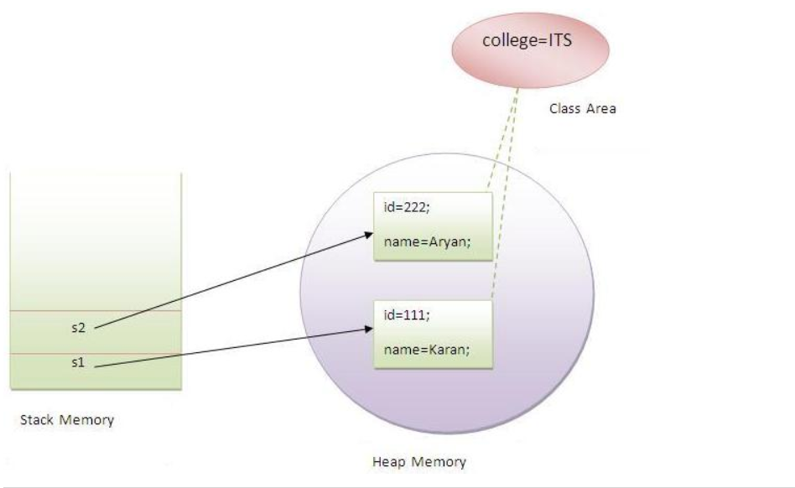
Memory Representation

Slide 83
Program of counter without static variable
In this example, we have created an instance variable named count which is incremented in the constructor. Since instance variable gets the memory at the time of object creation, each object will have the copy of the instance variable, if it is incremented, it won't reflect to other objects. So each objects will have the value 1 in the count variable.

Slide 84
Example
public class Counter {
int counter = 0;
public Counter() {
counter++;
System.out.println(counter);
}
public static void main(String[] args) {
Counter c1 = new Counter();
Counter c2 = new Counter();
Counter c3 = new Counter();
}
}

Slide 85
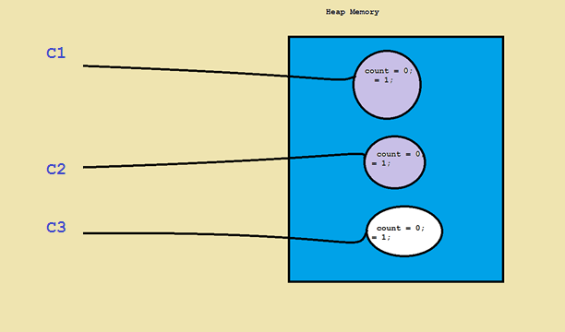
Memory Allocation

Slide 86
Program of counter by static variable
As we have mentioned above, static variable will get the memory only once, if any object changes the value of the static variable, it will retain its value.

Slide 87
Example
public class Counter {
static int counter = 0;
public Counter() {
counter++;
System.out.println(counter);
}
static int x = 10;
public static void main(String[] args) {
System.out.println(x);
Counter c1 = new Counter();
Counter c2 = new Counter();
Counter c3 = new Counter();
}
}

Slide 88
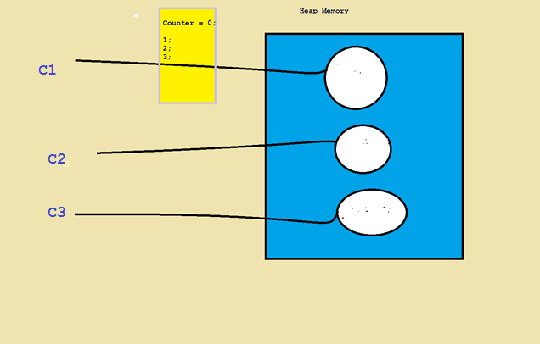
Memory Allocation

Slide 89
2. Java static method
If you apply static keyword with any method, it is known as static method.
A static method belongs to the class rather than object of a class.
A static method can be invoked without the need for creating an instance of a class.
static method can access static data member and can change the value of it.

Slide 90
Example of static method
public class CubeOfTheNumber {
static void cube(int x) {
System.out.println("cube of the no. " + (x * x * x));
}
public static void main(String[] args) {
CubeOfTheNumber .cube(10);
}
}

Slide 91
Notes
static variables and methods can be accessed using objects also But it is not recommended.
Ex:
Calculate calc = new Calculate();
calc.cube(5);
static variables and methods can be accessed with out using class name also when accessing them from same class
Eg:
int result=Calculate.cube(5);
System.out.println(result);

Slide 92
Restrictions for static method
The static method can not use non static data member or call non-static method directly.
this and super cannot be used in static context.

Slide 93
Instance method allows both static and non static variables
int x = 10; //instance variable
static int y = 20; // static variable
private void myMethod() { //instance method
x = 100;
y = 200;
System.out.println("x: "+x);
System.out.println("y: "+y);
}

Slide 94
***Can we access non static members from static method?
No – Directly
Yes – by using Object

Slide 95
Example
public class StaticMethodExample {
int x = 10; //instance method
private static void myMethod() {
//System.out.println("x: "+x); //compile time error
StaticMethodExample sm = new StaticMethodExample();
System.out.println("x: "+sm.x);
}
public static void main(String[] args) {
myMethod();
}
}

Slide 96
Guess the output
class A{
int a=40;//non static
public static void main(String args[]){
System.out.println(a);
}
}

Slide 97
Output
Compile time error

Slide 98
3. Java static block
Is used to initialize the static data member.
It is executed before main method at the time of classloading.

Slide 99
Example of static block
public class Test {
static{
System.out.println("static block is invoked");
}
public static void main(String[] args) {
System.out.println("main method is invoked");
}
}

Slide 100
Output
static block is invoked
main method is invoked

Slide 101
Guess the output
public class Test {
static Test t = new Test();
int x = 10;
static{
System.out.println(t.x);
}
public static void main(String[] args) {
}
}

Slide 102
output
10

Slide 103
4. Static nested class
A static class inside other class
public class A {
static class B{ //static nested class
//statements
}
}

Slide 104
Q) Can we execute a program without main() method?
Yes up to JDK 6
public class A {
static{
System.out.println("static block");
System.exit(0);
}
}

Slide 105
Output
Static block is invoked

Slide 106
In JDK7 and above, output will be:
Output:Error: Main method not found in class A3, please define the main method as:
public static void main(String[] args)

Slide 107
this keyword
Java this keyword

Slide 108
this keyword
There can be a lot of usage of java this keyword. In java, this is a reference variable that refers to the current object.

Slide 109
Usage of java this keyword
1. this keyword can be used to refer current class instance variable.
2. this() can be used to invoke current class constructor.
3. this keyword can be used to invoke current class method (implicitly)

Slide 110
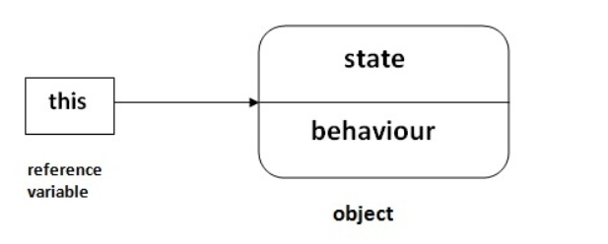
this

Slide 111
1. The this keyword can be used to refer current class instance variable.
If there is ambiguity between the instance variable and parameter, this keyword resolves the problem of ambiguity.

Slide 112
Understanding the problem without this keyword
class Student{
int id;
String name;
Student(int id,String name){
id = id;
name = name;
}
void display(){System.out.println(id+" "+name);}
public static void main(String args[]){
Student s1 = new Student(111,"Karan");
s1.display();
}
}

Slide 113
output
0 null
0 null

Slide 114
Solution of above program with this keyword
class Student{
int id;
String name;
Student(int id,String name){
this.id = id;
this.name = name;
}
void display(){System.out.println(id+" "+name);}
public static void main(String args[]){
Student s1 = new Student(111,"Karan");
s1.display();
}
}

Slide 115
Output
111 karan
222 Aryan

Slide 116
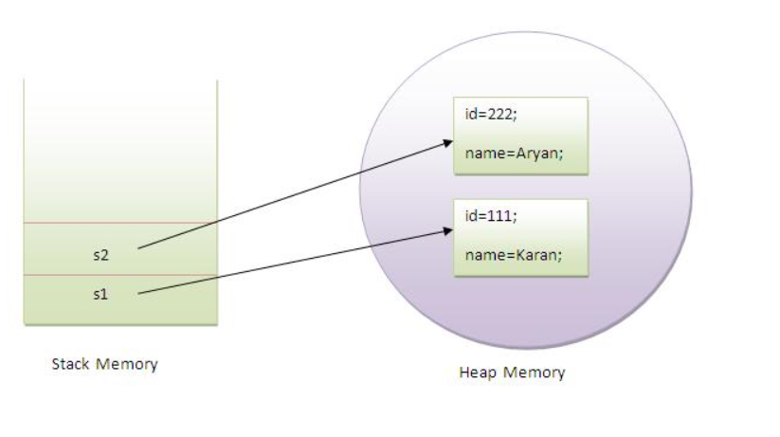
Memory representation

Slide 117
Program where this keyword is not required
class Student{
int id;
String name;
Student(int i,String n){
id = i;
name = n;
}
void display(){System.out.println(id+" "+name);}
public static void main(String args[]){
Student s1 = new Student(111,"Karan");
s1.display();
}
}

Slide 118
2. this() can be used to invoke current class constructor
The this() constructor call can be used to invoke the current class constructor (constructor chaining).
This approach is better if you have many constructors in the class and want to reuse that constructor.

Slide 119
Program of this() constructor call (constructor chaining)
class Student{
int id;
String name;
Student(){System.out.println("default constructor is invoked");}
Student(int id,String name){
this ();//it is used to invoked current class constructor.
this.id = id;
this.name = name;
}
void display(){System.out.println(id+" "+name);}
public static void main(String args[]){
Student s = new Student(111,"karan");
s.display();
}
}

Slide 120
Rule
Call to this() must be the first statement in constructor.

Slide 121
class Student{
int id;
String name;
Student(){System.out.println("default constructor is invoked");}
Student(int id,String name){
id = id;
name = name;
this ();//must be the first statement
}
void display(){System.out.println(id+" "+name);}
public static void main(String args[]){
Student s = new Student(111,"karan");
e1.display();
}
}

Slide 122
output
Compile time error

Slide 123
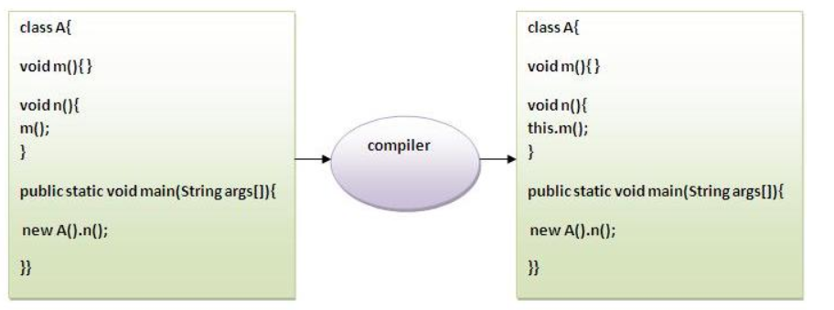
3)The this keyword can be used to invoke current class method (implicitly).
You may invoke the method of the current class by using the this keyword. If you don't use the this keyword, compiler automatically adds this keyword while invoking the method.

Slide 124
Example
class S{
void m(){
this.n();//no need because compiler does it for you.
}
void n(){
System.out.println(“n method is invoked");
}
public static void main(String args[]){
S s1 = new S();
s1.m();
}
}

Slide 125
Inheritance in Java
Inheritance in java is a mechanism in which one object acquires all the properties and behaviors of parent object.
The idea behind inheritance in java is that you can create new classes that are built upon existing classes. When you inherit from an existing class, you can reuse methods and fields of parent class, and you can add new methods and fields also.
Inheritance represents the IS-A relationship, also known as parent-child relationship.

Slide 126
Why use inheritance in java
For Method Overriding (so runtime polymorphism can be achieved).
For Code Reusability.

Slide 127
Syntax of Java Inheritance
class Subclass-name extends Superclass-name
{
//methods and fields
}
The extends keyword indicates that you are making a new class that derives from an existing class.
In the terminology of Java, a class that is inherited is called a super class. The new class is called a subclass.

Slide 128
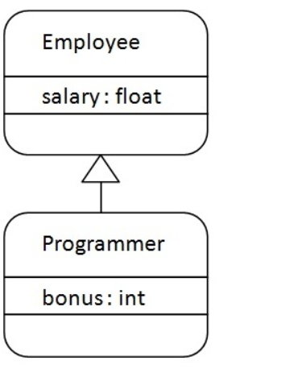
Understanding the simple example of inheritance

Slide 129
Note
As displayed in the above figure, Programmer is the subclass and Employee is the superclass. Relationship between two classes is Programmer IS-A Employee.It means that Programmer is a type of Employee.

Slide 130
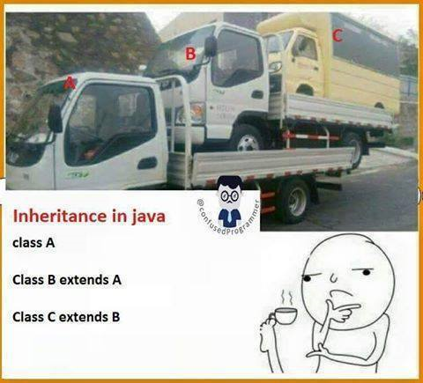
Inheritance funny example

Slide 131
Synonyms
Parent Super Base
: : :
: : :
: : :
: : :
: : :
Child Sub Derived

Slide 132
Example
class Employee{
int salary = 40000;
}
public class Programmer extends Employee{
int bonus = 10000;
public static void main(String[] args) {
Programmer prog = new Programmer();
System.out.println("bonus: "+prog.bonus);
System.out.println("salary: "+prog.salary);
System.out.println("Total Net sal: "+(prog.bonus+prog.salary));
}
}

Slide 133
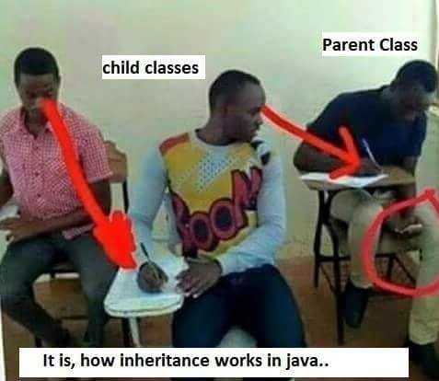

Slide 134
Types of inheritance in java
On the basis of class, there can be three types of inheritance in java: single, multilevel and hierarchical.
In java programming, multiple and hybrid inheritance is supported through interface only. We will learn about interfaces later.

Slide 135
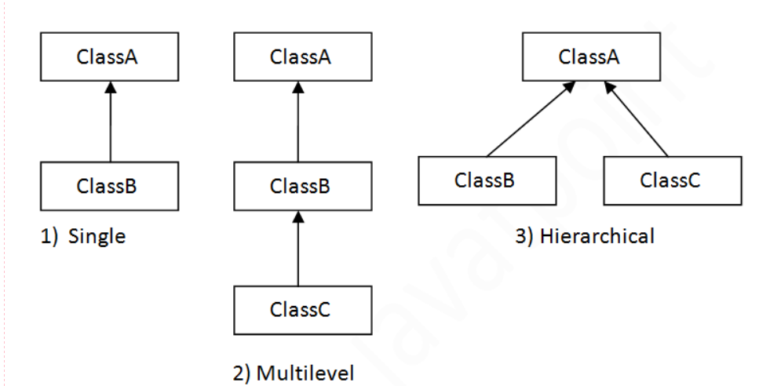
Types of Multiple Inheritances

Slide 136
Note
Multiple inheritance is not supported in java through class.
When a class extends multiple classes i.e. known as multiple inheritance. For Example:

Slide 137
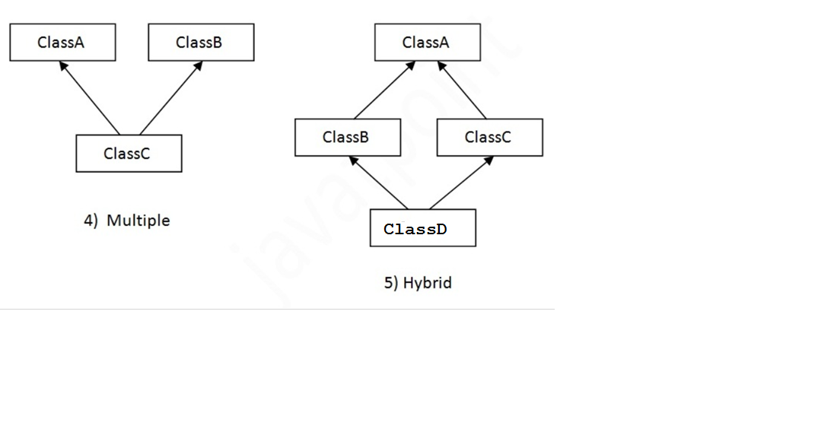
Types of Inheritance

Slide 138
Why multiple inheritance is not supported in java?
To reduce the complexity and simplify the language, multiple inheritance is not supported in java.
Consider a scenario where A, B and C are three classes. The C class inherits A and B classes. If A and B classes have same method and you call it from child class object, there will be ambiguity to call method of A or B class.
Since compile time errors are better than runtime errors, java renders compile time error if you inherit 2 classes. So whether you have same method or different, there will be compile time error now.

Slide 139
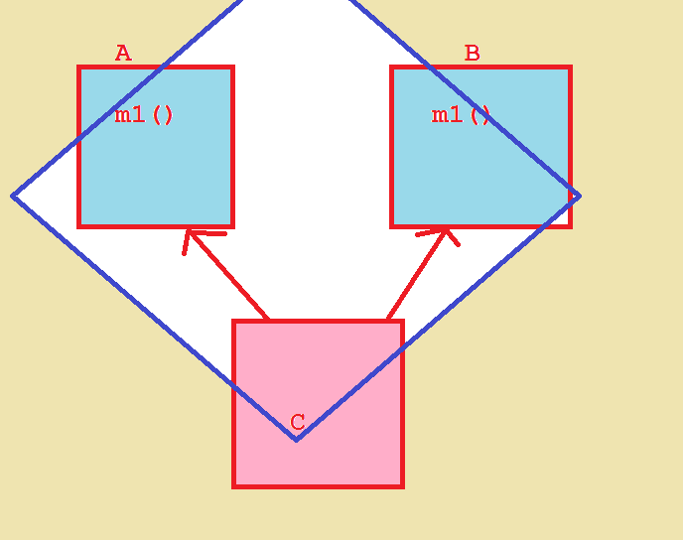
Ambiguity Problem

Slide 140
Example
class A{
void msg(){System.out.println("Hello");}
}
class B{
void msg(){System.out.println("Welcome");}
}
class C extends A,B{//suppose if it were
public Static void main(String args[]){
C obj=new C();
obj.msg();//Now which msg() method would be invoked?
}
}

Slide 141
output
Compile Time Error

Slide 142
Aggregation in Java
If a class have an entity reference, it is known as Aggregation. Aggregation represents HAS-A relationship.
Consider a situation, Employee object contains many information such as id, name, email ID etc. It contains one more object named address, which contains its own information such as city, state, country, zipcode etc.

Slide 143
Is-A relation Examples
IS- A relation
Vehicle Animal
| |
| |
Car Cat
Eg:
Car is a Vehicle
Cat is a Animal

Slide 144
Has-A relation example
Vehicle ----- Engine
Vehicle Has A Engine
Employee – Address
Employee Has A address

Slide 145
Why use Aggregation?
For Code Reusability.

Slide 146
When use Aggregation?
Code reuse is also best achieved by aggregation when there is no is-a relationship.
Inheritance should be used only if the relationship is-a is maintained throughout the lifetime of the objects involved; otherwise, aggregation is the best choice.

Slide 147
Understanding meaningful example of Aggregation
Employee has an object of Address, address object contains its own information such as city, state, country etc.
In such case relationship is Employee HAS-A address.

Slide 148
Employee has an entity reference address, so relationship is Employee HAS-A address.
public class Employee {
int id=101;
String name="AMR";
//Employee Has an Address
Static Address address;
public static void main(String[] args) {
address = new Address();
Employee e = new Employee();
System.out.println("Employee details.... ");
System.out.println(e.id);
System.out.println(e.name);
System.out.println(address.city);
}}

Slide 149
Address.java
public class Address {
String city="Hyderabad";
String state = "Telangana";
}

Slide 150
Method Overriding in Java
Method overriding

Slide 151
Method Overriding
If subclass (child class) has the same method as declared in the parent class, it is known as method overriding in java.
In other words, If subclass provides the specific implementation of the method that has been provided by one of its parent class, it is known as method overriding.

Slide 152
Usage of Java Method Overriding
Method overriding is used to provide specific implementation of a method that is already provided by its super class.
Method overriding is used for runtime polymorphism

Slide 153
Rules for Java Method Overriding
method must have same name as in the parent class
method must have same parameter as in the parent class.
must be IS-A relationship (inheritance).

Slide 154
Understanding the problem without method overriding
class Vehicle{
void run(){System.out.println("Vehicle is running");}
}
class Bike extends Vehicle{
public static void main(String args[]){
Bike obj = new Bike();
obj.run();
}
}

Slide 155
Output
Output: Vehicle is running

Slide 156
Problem
Problem is that I have to provide a specific implementation of run() method in subclass that is why we use method overriding.

Slide 157
Example of method overriding
class Vehicle{
void run(){System.out.println("Vehicle is running");}
}
class Bike2 extends Vehicle{
void run(){System.out.println("Bike is running safely");}
public static void main(String args[]){
Bike2 obj = new Bike2();
obj.run();
}

Slide 158
Output
Bike is running safely

Slide 159
Example of Method overriding
class Animal{
void eat(){System.out.println("eating...");}
}
class Dog extends Animal{
void eat(){System.out.println("eating bread...");}
}

Slide 160
Real example of Java Method Overriding
Consider a scenario, Bank is a class that provides functionality to get rate of interest. But, rate of interest varies according to banks.
For example, SBI, ICICI and AXIS banks could provide 8%, 7% and 9% rate of interest.

Slide 161
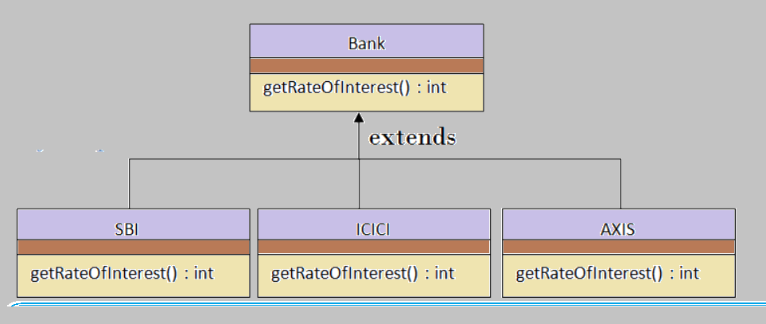
Real-time Example for method overriding

Slide 162
Example
class Bank{
int getRateOfInterest(){return 0;}
}
class SBI extends Bank{
int getRateOfInterest(){return 8;}
}
class ICICI extends Bank{
int getRateOfInterest(){return 7;}
}
class AXIS extends Bank{
int getRateOfInterest(){return 9;}
}

Slide 163
Test Class
class Test{
public static void main(String args[]){
SBI s=new SBI();
ICICI i=new ICICI();
AXIS a=new AXIS();
System.out.println("SBI Rate of Interest: "+s.getRateOfInterest());
System.out.println("ICICI Rate of Interest: "+i.getRateOfInterest());
System.out.println("AXIS Rate of Interest: "+a.getRateOfInterest());
}
}

Slide 164
output
SBI Rate of Interest: 8
ICICI Rate of Interest: 7
AXIS Rate of Interest: 9

Slide 165
Can we override static method?
No, static method cannot be overridden

Slide 166
Why we cannot override static method?
because static method is bound with class whereas instance method is bound with object. Static belongs to class area and instance belongs to heap area.

Slide 167
Can we override java main method?
No, because main is a static method.

Slide 168
Difference between method Overloading and Method Overriding in java
No. | Method Overloading | Method Overriding
1) | Method overloading is used to increase the readability of the program. | Method overriding is used to provide the specific implementation of the method that is already provided by its super class.
2) | Method overloading is performed within class. | Method overriding occurs in two classes that have IS-A (inheritance) relationship.
3) | In case of method overloading, parameter must be different. | In case of method overriding, parameter must be same.
4) | Method overloading is the example of compile time polymorphism. | Method overriding is the example of run time polymorphism.
5) | In java, method overloading can't be performed by changing return type of the method only. Return type can be same or different in method overloading. But you must have to change the parameter. | Return type must be same or covariant in method overriding.

Slide 169
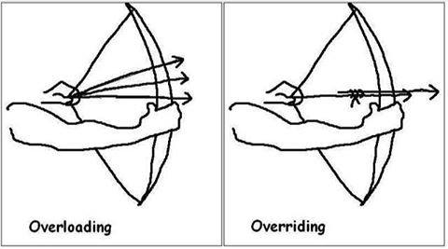
Overloading Vs Overriding ☺ ☺ ☺

Slide 170

Method overloading example – Bahubali 2

Slide 171
Difference between overloading and overriding
Overloading
Overriding
class OverloadingExample{
static int add(int a,int b){
return a+b;
}
static int add(int a,int b,int c){
return a+b+c;}
}
class Animal{
void eat(){
System.out.println("eating...");
}
}
class Dog extends Animal{
void eat(){
System.out.println("eating bread...");
}
}

Slide 172
Covariant Return Type
Covariant return type

Slide 173
Covariant return type
The covariant return type specifies that the return type may vary in the same direction as the subclass.
Before Java5, it was not possible to override any method by changing the return type.
But now, since Java5, it is possible to override method by changing the return type if subclass overrides any method whose return type is Non-Primitive but it changes its return type to subclass type.

Slide 174
class A {
A get() {
return this;
}
}
class B extends A {
B get() { //covariant return type
return this;
}
void message() {
System.out.println("welcome to covariant return type");
}
public static void main(String args[]) {
new B().get().message();
}
}

Slide 175
Note
As you can see in the above example, the return type of the get() method of A class is A but the return type of the get() method of B class is B. Both methods have different return type but it is method overriding. This is known as covariant return type.

Slide 176
super keyword in java
Super Keyword

Slide 177
super keyword in java
The super keyword in java is a reference variable that is used to refer immediate parent class object.
Whenever you create the instance of subclass, an instance of parent class is created implicitly i.e. referred by super reference variable.

Slide 178
Usage of java super Keyword
super is used to refer immediate parent class instance variable.
super is used to invoke immediate parent class method.
super() is used to invoke immediate parent class constructor.

Slide 179
1) super is used to refer immediate parent class instance variable.

Slide 180
Problem without super keyword
class Vehicle{
int speed=50;
}
class Bike3 extends Vehicle{
int speed=100;
void display(){
System.out.println(speed);//will print speed of Bike
}
public static void main(String args[]){
Bike3 b=new Bike3();
b.display();
}
}

Slide 181
output
100

Slide 182
Solution by super keyword
class Vehicle{
int speed=50;
}
class Bike4 extends Vehicle{
int speed=100;
void display(){
System.out.println(super.speed);//will print speed of Vehicle now
}
public static void main(String args[]){
Bike4 b=new Bike4();
b.display();
}
}

Slide 183
Output
50

Slide 184
2) super can be used to invoke parent class method

Slide 185
class Person {
void message() {
System.out.println("welcome");
}
}
class Student extends Person {
void message() {
System.out.println("welcome to java");
}
void display() {
message();// will invoke current class message() method
super.message();// will invoke parent class message() method
}
public static void main(String args[]) {
Student s = new Student();
s.display();
}
}

Slide 186
Program in case super is not required
class Person {
void message() {
System.out.println("welcome");
}
}
class Student17 extends Person {
void display() {
message();// will invoke parent class message() method
}
public static void main(String args[]) {
Student17 s = new Student17();
s.display();
}
}

Slide 187
3) super is used to invoke parent class constructor.

Slide 188
Example
class Vehicle{
Vehicle(){System.out.println("Vehicle is created");}
}
class Bike5 extends Vehicle{
Bike5(){
super();//will invoke parent class constructor
System.out.println("Bike is created");
}
public static void main(String args[]){
Bike5 b=new Bike5();
}
}

Slide 189
Output
Vehicle is created
Bike is created

Slide 190
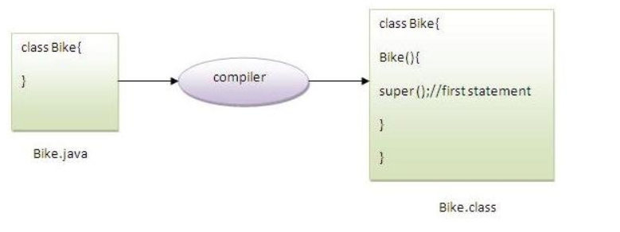
Note
super() is added in each class constructor automatically by compiler.
As we know well that default constructor is provided by compiler automatically but it also adds super() for the first statement.If you are creating your own constructor and you don't have either this() or super() as the first statement, compiler will provide super() as the first statement of the constructor.

Slide 191
Instance block

Slide 192
Instance block
Instance block is used to initialize the instance data member. It run each time when object of the class is created.
It used to initialize instance variable same like constructor

Slide 193
Example
class Bike{
int speed;
Bike(){System.out.println("speed is "+speed);}
{speed=100;}
public static void main(String args[]){
Bike b1=new Bike();
}
}

Slide 194
There are three places in java where you can perform operations
Method
Constructor
Block

Slide 195
What is invoked firstly instance initializer block or constructor?
public class InstanceBlockDemo {
public InstanceBlockDemo() {
System.out.println("constructor");
}
{
System.out.println("instance block 2");
}
{
System.out.println("instance block 1");
}
static{
System.out.println("static block");
}
public static void main(String[] args) {
new InstanceBlockDemo();
}
}

Slide 196
Output
static block
instance block 2
instance block 1
constructor

Slide 197
Notes
it seems that instance initializer block is firstly invoked but NO. Instance initializer block is invoked at the time of object creation.
The java compiler copies the instance initializer block in the constructor after the first statement super(). So firstly, constructor is invoked.

Slide 198
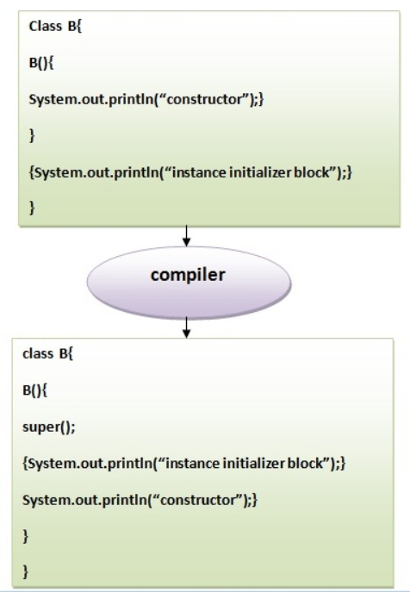
The java compiler copies the code of instance initializer block in every constructor.

Slide 199
Rules for instance block
The instance block is created when instance of the class is created.
The instance block is invoked after the parent class constructor is invoked (i.e. after super() constructor call).
The instance block comes in the order in which they appear.

Slide 200
*****Guess the output
public class Test {
{
System.out.println("Instance block");
new Test();
}
public static void main(String[] args) {
Test t = new Test();
}
}

Slide 201
Output
Exception in thread "main" java.lang.StackOverflowError

Slide 202
Final Keyword In Java
final

Slide 203
Final keyword
The final keyword in java is used to restrict the user. The java final keyword can be used in many context. Final can be:
variable
method
Class
The final keyword can be applied with the variables, a final variable that have no value it is called blank final variable or uninitialized final variable. It can be initialized in the constructor only.
The blank final variable can be static also which will be initialized in the static block only.

Slide 204
***Note
If you make any variable as final, you cannot change the value of final variable(It will be constant).

Slide 205
Final keyword
Stops values change
Stops method overriding
Stops inheritance

Slide 206
1. Java Final Variable
If you make any variable as final, you cannot change the value of final variable(It will be constant).

Slide 207
Example
class Bike{
final int speedlimit = 90;// final variable
void run() {
speedlimit = 400;
}
public static void main(String args[]) {
Bike obj = new Bike();
obj.run();
}
}// end of class

Slide 208
output
Compile time error

Slide 209
2. Final method
If you make any method as final, you cannot override it.

Slide 210
Example
class Bike {
final void run() {
System.out.println("running");
}
}
class Honda extends Bike {
void run() {
System.out.println("running safely with 100kmph");
}
public static void main(String args[]) {
Honda honda = new Honda();
honda.run();
}
}

Slide 211
output
Compile time error

Slide 212
3) Java final class
If you make any class final, you cannot extend it

Slide 213
Example
final class Bike{
}
class Honda1 extends Bike{
void run(){System.out.println("running safely with 100kmph");}
public static void main(String args[]){
Honda1 honda= new Honda();
honda.run();
}
}

Slide 214
output
Compile time error

Slide 215
***Is final method inherited?
Yes, But You cannot override it

Slide 216
Example
class Bike{
final void run(){System.out.println("running...");}
}
class Honda extends Bike{
public static void main(String args[]){
new Honda().run();
}
}

Slide 217
Output
Running……

Slide 218
What is blank or uninitialized final variable?
A final variable that is not initialized at the time of declaration is known as blank final variable.
If you want to create a variable that is initialized at the time of creating object and once initialized may not be changed, it is useful. For example PAN CARD number of an employee.
It can be initialized only in constructor or in block.

Slide 219
blank and static final variables
final int PI; //blank final variable
constructor(){
PI = 3.14;
}
final static int PI; //static blank final variable
static{
PI = 3.14;
}

Slide 220
Example of blank final variable
class Student {
int id;
String name;
final String PAN_CARD_NUMBER;
...
}

Slide 221
Can we initialize blank final variable?
Yes, but only in constructor or instance block

Slide 222
Example
class Bike {
final int speedlimit;// blank final variable
Bike() {
speedlimit = 70; //initialized inside constructor
System.out.println(speedlimit);
}
public static void main(String args[]) {
new Bike10();
}
}

Slide 223
static blank final variable
A static final variable that is not initialized at the time of declaration is known as static blank final variable.
It can be initialized only in static block.

Slide 224
Example of static blank final variable
class A {
static final int data;// static blank final variable
static {
data = 50;
}
public static void main(String args[]) {
System.out.println(A.data);
}
}

Slide 225
What is final parameter?
If you declare any parameter as final, you cannot change the value of it.

Slide 226
Example
class Bike11 {
int cube(final int n){
n=n+2;//can't be changed as n is final
n*n*n;
}
public static void main(String args[]) {
Bike11 b = new Bike11();
b.cube(5);
}
}

Slide 227
Can we declare a constructor final?
No, because constructor is never inherited.

Slide 228
Runtime Polymorphism
Dynamic Polymorphism

Slide 229
Runtime Polymorphism
Runtime polymorphism ,Dynamic Polymorphism, and Dynamic Method Dispatch all are same.
In this process, an overridden method is called through the reference variable of a superclass.
The determination of the method to be called is based on the object being referred to by the reference variable.

Slide 230
Example of Java Runtime Polymorphism
class Bike {
void run() {
System.out.println("running");
}
}
class Splender extends Bike {
void run() {
System.out.println("running safely with 60km");
}
public static void main(String args[]) {
Bike b = new Splender();// upcasting
b.run();
}
}

Slide 231
output
running safely with 60km.

Slide 232
Note
In the above example, we are creating two classes Bike and Splendar. Splendar class extends Bike class and overrides its run() method. We are calling the run method by the reference variable of Parent class. Since it refers to the subclass object and subclass method overrides the Parent class method, subclass method is invoked at runtime.
Since method invocation is determined by the JVM not compiler, it is known as runtime polymorphism.

Slide 233
Java Runtime Polymorphism with field
class Bike{
int speedlimit=90;
}
class Honda3 extends Bike{
int speedlimit=150;
public static void main(String args[]){
Bike obj=new Honda3();
System.out.println(obj.speedlimit);
}

Slide 234
Note
Method is overridden not the field, so runtime polymorphism can't be achieved by field.
In the example given above, both the classes have a field speedlimit, we are accessing the field by the reference variable of Parent class which refers to the subclass object. Since we are accessing the field which is not overridden, hence it will access the field of Parent class always.

Slide 235
***Rule
Runtime polymorphism can't be achieved by fields.

Slide 236
Abstract class in Java
Abstract class

Slide 237
Abstract Class
A class that is declared with abstract keyword, is known as abstract class in java. It can have abstract and non-abstract methods (method with body) or no methods
Abstract class needs to be extended and its method implemented. It cannot be instantiated.

Slide 238
Ways to achieve Abstraction
There are two ways to achieve abstraction in java
Abstract class (0 to 100%)
Interface (100%)

Slide 239
Note
abstract is a keyword

Slide 240
Example
abstract class A{
}

Slide 241
Abstract Method
A method that is declared as abstract and does not have implementation is known as abstract method.

Slide 242
Example abstract method
abstract void printStatus();//no body and abstract

Slide 243
Example of abstract class that has abstract method
abstract class Bike{
abstract void run();
}
class Honda extends Bike{
void run(){
System.out.println("running safely..");
}
public static void main(String args[]){
Bike obj = new Honda();
obj.run();
}
}

Slide 244
Abstract class having constructor, data member, methods etc.
An abstract class can have fields, abstract methods, concrete methods, constructors and even main() method.

Slide 245
***TestAbstraction2.java
//example of abstract class that have method body
abstract class Bike{
Bike(){System.out.println("bike is created");}
abstract void run();
void changeGear(){System.out.println("gear changed");}
}
class Honda extends Bike{
void run(){System.out.println("running safely..");}
}
class TestAbstraction2{
public static void main(String args[]){
Bike obj = new Honda();
obj.run();
obj.changeGear();
}

Slide 246
Output
bike is created
running safely..
gear changed

Slide 247
Note
If there is any abstract method in a class, that class must be abstract.

Slide 248
Example
class Bike{
abstract void run();
}

Slide 249
output
Compile time error

Slide 250
Rule
If you are extending any abstract class that has abstract method, you must either provide the implementation of the method or make this class abstract.

Slide 251
Note
The abstract class can also be used to provide some implementation of the interface. In such case, the end user may not be forced to override all the methods of the interface.

Slide 252
Interfaces
Java interfaces

Slide 253
Interface
An interface in java is a blueprint of a class. It has static constants and abstract methods only.
The interface in java is a mechanism to achieve fully abstraction. There can be only abstract methods in the java interface not method body. It is used to achieve fully abstraction and multiple inheritance in Java.
Java Interface also represents IS-A relationship.
It cannot be instantiated just like abstract class.

Slide 254
Industry definition of Interface
It’s a service requirement specification between service provider and end user (client)
Ex:
Interface Bank{
void withdraw();
void deposit();
void tranfer();
void checkBalance();
}

Slide 255
Why use Java interface?
It is used to achieve fully abstraction.
By interface, we can support the functionality of multiple inheritance.
It can be used to achieve loose coupling.

Slide 256
Notes
Interface fields are public, static and final by default, and methods are public and abstract.
The java compiler adds public and abstract keywords before the interface method and public, static and final keywords before fields.

Slide 257
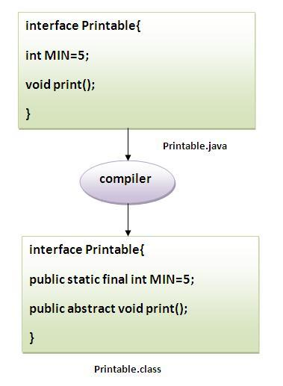

Slide 258
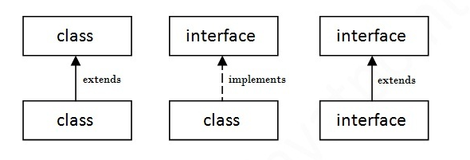
Understanding relationship between classes and interfaces
a class extends another class, an interface extends another interface but a class implements an interface.

Slide 259
Example
interface printable{
void print();
}
class A implements printable{
public void print(){
System.out.println("Hello");
}
public static void main(String args[]){
A obj = new A();
obj.print();
}
}

Slide 260
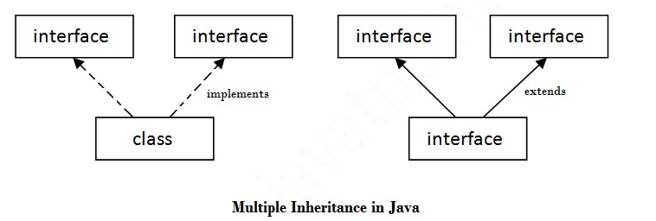
Multiple inheritance in Java by interface

Slide 261
Multiple inheritance is not supported through class in java but it is possible by interface, why?
There is no ambiguity as implementation is provided by the implementation class

Slide 262
Multiple Inheritance Example with interfaces
interface Printable{
void print();
}
interface Showable{
void print();
}
class TestTnterface implements Printable,Showable{
public void print(){System.out.println("Hello");}
public static void main(String args[]){
TestTnterface obj = new TestTnterface();
obj.print();
}
}

Slide 263
Note
As you can see in the above example, Printable and Showable interface have same methods but its implementation is provided by class TestTnterface, so there is no ambiguity.

Slide 264
Interface inheritance
A class implements interface but one interface extends another interface .

Slide 265
Example
interface Printable{
void print();
}
interface Showable extends Printable{
void show();
}
class Testinterface implements Showable{
public void print(){System.out.println("Hello");}
public void show(){System.out.println("Welcome");}
public static void main(String args[]){
Testinterface obj = new Testinterface();
obj.print();
obj.show();
}
}

Slide 266
What is marker or tagged interface?
An interface that have no methods is known as marker or tagged interface. For example:
1. Serializable,
2. Cloneable
3. Remote etc.
They are used to provide some essential information to the JVM so that JVM may perform some useful operation

Slide 267
How Serializable interface is written?
public interface Serializable{
}

Slide 268
Nested Interface in Java
An interface can have another interface i.e. known as nested interface
interface printable{
void print();
interface MessagePrintable{
void msg();
}
}

Slide 269
Difference between abstract class and interface
Common things:
Abstract class and interface both are used to achieve abstraction where we can declare the abstract methods.
Abstract class and interface both can't be instantiated.
Differences:
Refer next slide

Slide 270
Abstract class | Interface
1) Abstract class can have abstract and non-abstract methods. | Interface can have only abstract methods.
2) Abstract class doesn't support multiple inheritance. | Interface supports multiple inheritance.
3) Abstract class can have final, non-final, static and non-static variables. | Interface has only static and final variables.
4) Abstract class can have static methods, main method and constructor. | Interface can't have static methods, main method or constructor.
5) Abstract class can provide the implementation of interface. | Interface can't provide the implementation of abstract class.
6) The abstract keyword is used to declare abstract class. | The interface keyword is used to declare interface.
7) Example: public abstract class Shape{ public abstract void draw(); } | Example: public interface Drawable{ void draw(); }

Slide 271
Example of abstract class and interface in Java
Let’s see the example where how we are using both interface and abstract class

Slide 272
//Creating interface that has 4 methods
interface A{
void a();//bydefault, public and abstract
void b();
void c();
void d();
}
//Creating abstract class that provides the implementation of one method of A interface
abstract class B implements A{
public void c(){System.out.println("I am C");}
}
//Creating subclass of abstract class, now we need to provide the implementation of rest of the methods
class M extends B{
public void a(){System.out.println("I am a");}
public void b(){System.out.println("I am b");}
public void d(){System.out.println("I am d");}
}
//Creating a test class that calls the methods of A interface
class Test5{
public static void main(String args[]){
A a=new M();
a.a();
a.b();
a.c();
a.d();
}}

Slide 273
Packages
Java Package

Slide 274
Packages
A java package is a group of classes, interfaces and sub-packages.
Package in java can be categorized in two form, built-in package and user-defined package.
There are many built-in packages such as java, lang, awt, javax, swing, net, io, util, sql etc.
Here, we will have the detailed learning of creating and using user-defined packages.

Slide 275
Advantage of Java Package
1) Java package is used to categorize the classes and interfaces so that they can be easily maintained.
2) Java package provides access protection.
3) Java package removes naming collision.

Slide 276
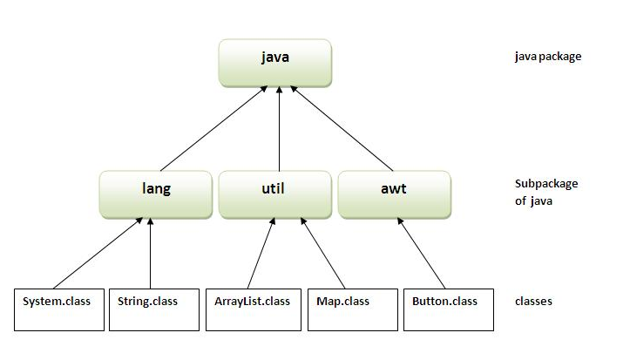
Sample Package hierarchy

Slide 277
Package keyword
The package keyword is used to create a package in java.

Slide 278
Example
//save as Simple.java
package mypack;
public class Simple{
public static void main(String args[]){
System.out.println("Welcome to package");
}
}

Slide 279
How to compile java package
If you are not using any IDE, you need to follow the syntax given below:
Javac –d path Simple.java
Javac -d . Simple.java
Note: . Represents current directory

Slide 280
How to run package program
You need to use fully qualified name e.g. mypack.Simple etc to run the class.
Ex:
Java myPack.Simple

Slide 281
Notes
To Compile: javac . Simple.java
To Run: java mypack.Simple

Slide 282
How to access package from another package?
import package.*;
import package.classname;
fully qualified name;

Slide 283
1) Using packagename.*
If you use package.* then all the classes and interfaces of this package will be accessible but not sub packages.
The import keyword is used to make the classes and interface of another package accessible to the current package.

Slide 284
Example of package that import the packagename.*
package pack;
public class A{
public void msg(){System.out.println("Hello");}
}
package mypack;
import pack.*;
class B{
public static void main(String args[]){
A obj = new A();
obj.msg();
}
}

Slide 285
2) Using packagename.classname
If you import package.classname then only declared class of this package will be accessible.

Slide 286
Example of package by import package.classname
package pack;
public class A{
public void msg(){System.out.println("Hello");}
}
package mypack;
import pack.A;
class B{
public static void main(String args[]){
A obj = new A();
obj.msg();
}
}

Slide 287
3) Using fully qualified name
If you use fully qualified name then only declared class of this package will be accessible. Now there is no need to import. But you need to use fully qualified name every time when you are accessing the class or interface.
It is generally used when two packages have same class name e.g. java.util and java.sql packages contain Date class.

Slide 288
Example of package by import fully qualified name
package pack;
public class A{
public void msg(){System.out.println("Hello");}
}
package mypack;
class B{
public static void main(String args[]){
pack.A obj = new pack.A();//using fully qualified name
obj.msg();
}
}

Slide 289
**Note
If you import a package, sub packages will not be imported.
If you import a package, all the classes and interface of that package will be imported excluding the classes and interfaces of the subpackages. Hence, you need to import the subpackage as well.

Slide 290
Note: Sequence of the program must be package then import then class
Package
Import
Class

Slide 291
Subpackage
Package inside the package is called the subpackage. It should be created to categorize the package further.
Let's take an example, Sun Microsystem has definded a package named java that contains many classes like System, String, Reader, Writer, Socket etc. These classes represent a particular group e.g. Reader and Writer classes are for Input/Output operation, Socket and ServerSocket classes are for networking etc and so on. So, Sun has subcategorized the java package into subpackages such as lang, net, io etc. and put the Input/Output related classes in io package, Server and ServerSocket classes in net packages and so on.

Slide 292
The standard of defining package
domain.company.packag
Ex
com.mangaraoit.control
Org.mangaraoit.dao

Slide 293
Example of Subpackage
package com.mangaraoit.core;
class Simple{
public static void main(String args[]){
System.out.println("Hello subpackage");
}
}

Slide 294
Notes
To Compile: javac -d . Simple.java
To Run: java com.mangaraoit.core.Simple

Slide 295
Access Modifiers
Access Modifiers

Slide 296
Modifiers in java
1. Access Modifiers
2. Non Access Modifiers

Slide 297
Access Modifiers
1. private
2. default
3. protected
4. public

Slide 298
Many non-access modifiers
static
abstract
synchronized
final
transient
etc..

Slide 299
1) private access modifier
The private access modifier is accessible with in the class only

Slide 300
Example of Private Access Modifier
class A{
private int data=40; //private variable
private void msg(){ //private method
System.out.println("Hello java");
}
}
public class Simple{
public static void main(String args[]){
A obj=new A();
System.out.println(obj.data);//Compile Time Error
obj.msg();//Compile Time Error
}
}

Slide 301
Private Constructor
If you make any class constructor private, you cannot create the instance of that class from outside the class.

Slide 302
Example of Private Constructor
class A{
private A(){}//private constructor
void msg(){System.out.println("Hello java");}
}
public class Simple{
public static void main(String args[]){
A obj=new A();//Compile Time Error
}
}

Slide 303
***Note
A class cannot be private or protected except nested class

Slide 304
2) default access modifier
If you don't use any modifier, it is treated as default by default. The default modifier is accessible only within package.

Slide 305
Example
package pack;
class A{
void msg(){System.out.println("Hello");}
}
package mypack;
import pack.*;
class B{
public static void main(String args[]){
A obj = new A();//Compile Time Error
obj.msg();//Compile Time Error
}
}

Slide 306
3) protected access modifier
The protected access modifier is accessible within package and outside the package but through inheritance only.
The protected access modifier can be applied on the data member, method and constructor. It can't be applied on the class.

Slide 307
Example of protected access modifier
package pack1;
public class A {
protected void m1(){
System.out.println("m1 method");
}}
package pack2;
import pack1.A;
public class B extends A{
public static void main(String[] args) {
B b = new B();
b.m1();
}}

Slide 308
output
M1 method

Slide 309
4) public access modifier
The public access modifier is accessible everywhere. It has the widest scope among all other modifiers.

Slide 310
Example of public access modifier
package pack;
public class A{
public void msg(){System.out.println("Hello");}
}
package mypack;
import pack.*;
class B{
public static void main(String args[]){
A obj = new A();
obj.msg();
}
}

Slide 311
Understanding all java access modifiers
Access Modifier | within class | within package | outside package by subclass only | outside package
Private | Y | N | N | N
Default | Y | Y | N | N
Protected | Y | Y | Y | N
Public | Y | Y | Y | Y

Slide 312
***Java access modifiers with method overriding
class A{
protected void msg(){System.out.println("Hello java");}
}
public class Simple extends A{
void msg(){System.out.println("Hello Simple Java");}//C.T.Error
public static void main(String args[]){
Simple obj=new Simple();
obj.msg();
}
}

Slide 313
output
Compile time error
The default modifier is more restrictive than protected. That is why there is compile time error.

Slide 314
Difference between access modifiers vs access specifiers
Java has basically 2 types of Modifiers:
access modifiers
non-access modifiers
java access modifiers and Java access specifiers are the same thing, which are public, private, protected and default.
The term Access specifier used by c++ programmers not in java. In java Officially we use Access Modifier.

Slide 315
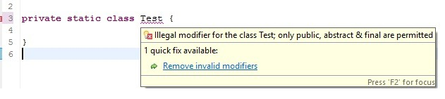
For example: when we declare a class with private, static the compiler clearly shows the error message as follows:

Slide 316
Encapsulation
Encapsulation in Java

Slide 317
Encapsulation in Java
It’s a process of wrapping code and data together into a single unit
For example capsule i.e. mixed of several medicines.
We can create a fully encapsulated class in java by making all the data members of the class private. Now we can use setter and getter methods to set and get the data in it.
The Java Bean class is the example of fully encapsulated class.

Slide 318
Advantage of Encapsulation in java
By providing only setter or getter method, you can make the class read-only or write-only.
It provides you the control over the data. Suppose you want to set the value of id i.e. greater than 100 only, you can write the logic inside the setter method.

Slide 319
Example of Encapsulation
package com.mangaraoit;
public class Student{
private String name;
public String getName(){
return name;
}
public void setName(String name){
this.name=name
}
}
package com.mangaraoit;
class Test{
public static void main(String[] args){
Student s=new Student();
s.setname(“NTR");
System.out.println(s.getName());
}
}

Slide 320
Object Cloning

Slide 321
Object Cloning
The object cloning is a way to create exact copy of an object. For this purpose, clone() method of Object class is used to clone an object.
The java.lang.Cloneable interface must be implemented by the class whose object clone we want to create. If we don't implement Cloneable interface, clone() method generates CloneNotSupportedException.
The clone() method is defined in the Object class.

Slide 322
Syntax of the clone() method
protected Object clone() throws CloneNotSupportedException

Slide 323
Why use clone() method ?
The clone() method saves the extra processing task for creating the exact copy of an object. If we perform it by using the new keyword, it will take a lot of processing to be performed that is why we use object cloning.

Slide 324
Advantage of Object cloning
Less processing task.

Slide 325
Example
public class Student implements Cloneable {
int id = 101;
String name = "Mohan";
public static void main(String[] args) throws CloneNotSupportedException {
Student s1 = new Student();
System.out.println(s1.id + " "+s1.name);
Student s2 = (Student) s1.clone(); //duplicate object creation
System.out.println("s2 obj data");
System.out.println(s2.id+" "+s2.name);
}
}

Slide 326
Note
As you can see in the above example, both reference variables have the same value. Thus, the clone() copies the values of an object to another. So we don't need to write explicit code to copy the value of an object to another.
If we create another object by new keyword and assign the values of another object to this one, it will require a lot of processing on this object. So to save the extra processing task we use clone() method.

Slide 327
Wrapper class

Slide 328
Wrapper class
Wrapper class in java provides the mechanism to convert primitive into object and object into primitive.

Slide 329
autoboxing
The automatic conversion of primitive into object is known as autoboxing

Slide 330
auto unboxing
The automatic conversion of Object into Primitive is known and auto unboxing.

Slide 331
Note
Since J2SE 5.0, autoboxing and unboxing feature converts primitive into object and object into primitive automatically.

Slide 332
Primitive Types and Object Types
Primitive Type | Wrapper class
boolean | Boolean
char | Character
byte | Byte
short | Short
int | Integer
long | Long
float | Float
double | Double

Slide 333
Wrapper class Example: Primitive to Wrapper
public class WrapperExample1{
public static void main(String args[]){
//Converting int into Integer
int a=20;
Integer i=Integer.valueOf(a);//converting int into Integer
Integer j=a;//autoboxing, now compiler will write Integer.valueOf(a) internally
System.out.println(a+" "+i+" "+j);
}
}

Slide 334
Wrapper class Example: Wrapper to Primitive
public class WrapperExample2{
public static void main(String args[]){
//Converting Integer to int
Integer a=new Integer(3);
int i=a.intValue();//converting Integer to int
int j=a;//auto unboxing, now compiler will write a.intValue() internally
System.out.println(a+" "+i+" "+j);
}
}

Slide 335
Call by Value and Call by Reference in Java

Slide 336
Call by value
If we call a method by passing a primitive value, it is known as call by value. The changes being done in the called method, is not affected in the calling method.

Slide 337
Example
class Operation{
int data=50;
void change(int data){
data=data+100;//changes will be in the local variable only
}
public static void main(String args[]){
Operation op=new Operation();
System.out.println("before change "+op.data);
op.change(500);
System.out.println("after change "+op.data);
}
}

Slide 338
Output
Before change: 50
After change: 50

Slide 339
Call by Reference
In case of call by reference original value is changed if we made changes in the called method. If we pass object in place of any primitive value, original value will be changed. In this example we are passing object as a value

Slide 340
Call by Reference
class Operation2{
int data=50;
void change(Operation2 op){
op.data=op.data+100;//changes will be in the instance variable
}
public static void main(String args[]){
Operation2 op=new Operation2();
System.out.println("before change "+op.data);
op.change(op);//passing object
System.out.println("after change "+op.data);
}
}

Slide 341
Output
Before change: 50
After change: 150

Slide 342
Strictfp Keyword
Strictfp Keyword

Slide 343
Strictfp Keyword
Java strictfp keyword ensures that you will get the same result as per IEEE’s 754 standard on every platform if you perform operations in the floating-point variable . The precision may differ from platform to platform that is why java programming language have provided the strictfp keyword, so that you get same result on every platform. So, now you have better control over the floating-point arithmetic.

Slide 344
Float or Double values on various platforms seems like
float f = 3.1456565656 //windows
float f = 3.1456666666 //linux
float f = 3.1455555555 //mac

Slide 345
Rules
strictfp cannot be applied for constructors.
If an interface or class is declared with strictfp, then all methods and nested types within that interface or class are implicitly strictfp.
strictfp cannot be applied for interface methods.

Slide 346
Examples

Slide 347
The following class is declared with strictfp, hence all the floating point computations within that class conform to IEEE’s 754 standard:
strictfp class StrictFPClass {
double num1 = 10e+102;
double num2 = 6e+08;
double calculate() {
return num1 + num2;
}
}

Slide 348
The following interface is declared with strictfp, but its methods cannot:
strictfp interface StrictFPInterface {
double calculate();
strictfp double compute(); // compile error
}

Slide 349
The following method is declared with strictfp:
class StrictFPMethod {
strictfp double computeTotal(double x, double y) {
return x * y;
}
}

Slide 350
Legal code for strictfp keyword
The strictfp keyword can be applied on methods, classes and interfaces.
1. strictfp class A{}//strictfp applied on class
2. strictfp interface M{}//strictfp applied on interface
3. class A{
strictfp void m(){}//strictfp applied on method
}

Slide 351
Illegal code for strictfp keyword
The strictfp keyword can not be applied on abstract methods, variables or constructors.
1. class B{
strictfp abstract void m();//Illegal combination of modifiers
}
2. class B{
strictfp int data=10;//modifier strictfp not allowed here
}
3. class B{
strictfp B(){}//modifier strictfp not allowed here
}

